Slide 1

COURSE SLIDES · WSQ
QUANTUM
Securing the Future with Quantum Computing and Cryptography
WSQ Course Code: TGS-2024043419
Conducted by Tertiary Infotech Academy Pte Ltd · UEN 201200696W
Version 11.0 · 11 August 2026
© 2026 Tertiary Infotech Academy Pte Ltd. All rights reserved. · www.tertiarycourses.com.sg

Slide 2
COURSE ADMINISTRATION
Welcome & Housekeeping
Securing the Future with Quantum Computing and Cryptography · TGS-2024043419
© 2026 Tertiary Infotech Academy Pte Ltd
1

Slide 3
TRAQOM · SSG DIGITAL ATTENDANCE
Digital Attendance (Mandatory)
1
2
3
4
▶
▶
▶
Trainer displays the digital attendance QR code from the SSG portal
Scan the QR code with your mobile phone camera
Submit your attendance — AM, PM and Assessment, every day
75% minimum attendance is required for assessment and funding
Securing the Future with Quantum Computing and Cryptography · TGS-2024043419
© 2026 Tertiary Infotech Academy Pte Ltd
2

Slide 4
YOUR TRAINER · GENERAL
About the Trainer
NAME
____________________________________________
?
TITLE / DESIGNATION
____________________________________________
QUALIFICATIONS
____________________________________________
Your Trainer
AREAS OF EXPERTISE
____________________________________________
General Trainer template —
to be completed by the trainer
TRAINING & INDUSTRY EXPERIENCE
____________________________________________
CONTACT
____________________________________________
Securing the Future with Quantum Computing and Cryptography · TGS-2024043419
© 2026 Tertiary Infotech Academy Pte Ltd
3

Slide 5
YOUR TRAINER
About the Trainer
ROLE
Principal Trainer, Tertiary Infotech Academy Pte Ltd
AA
QUALIFICATIONS
PhD; ACTA / DACE certified adult educator.
EXPERTISE
Quantum computing, quantum cryptography, data science and AI engineering.
Dr Alfred Ang
DELIVERS
WSQ courses on quantum computing, cybersecurity and applied machine learning.
Principal Trainer
Tertiary Infotech Academy Pte Ltd
FOUNDER
Founder and lead instructor at Tertiary Infotech / Tertiary Courses.
Securing the Future with Quantum Computing and Cryptography · TGS-2024043419
© 2026 Tertiary Infotech Academy Pte Ltd
4

Slide 6
ICE-BREAKER
Let's Know Each Other
• Your name, organisation and role.
• Your background in physics, mathematics or programming (if any).
• What you want to be able to do with quantum computing after this course.
Securing the Future with Quantum Computing and Cryptography · TGS-2024043419
© 2026 Tertiary Infotech Academy Pte Ltd
5

Slide 7
HOUSEKEEPING
Ground Rules
Set your mobile phone to silent mode.
Participate actively — no question is too small.
1
2
Mutual respect: agree to disagree.
One conversation at a time.
3
4
Be punctual; return from breaks on time.
75% attendance is required for funding.
5
6
Securing the Future with Quantum Computing and Cryptography · TGS-2024043419
© 2026 Tertiary Infotech Academy Pte Ltd
6

Slide 8
COURSE PORTAL · LMS/TMS
Download Your Course Material
https://lms-tms.tertiaryinfotech.com
Go to lms-tms.tertiaryinfotech.com and sign in with the account you were issued.
1
My Courses
Securing the Future with Quantum Computing and Cryptography
Open My Courses and select this course.
2
Course Materials
Trainer Slides · Learner Guide · Lesson Plan
Download the Trainer Slides, Learner Guide and Lesson Plan.
Activities / Labs
Lab source code and QASM files
3
Assessment
Submit your WA and PP answers here
Keep them open — the assessment is OPEN BOOK.
4
Download the slides and Learner Guide BEFORE the assessment — they are your permitted open-book materials.
Securing the Future with Quantum Computing and Cryptography · TGS-2024043419
© 2026 Tertiary Infotech Academy Pte Ltd
7

Slide 9
WHAT YOU'LL ACHIEVE
Learning Outcomes
1
LO1 · Mathematical models
Design the mathematical models required for quantum computing applications.
2
LO2 · Physical methodologies
Decide on appropriate physical methodologies for quantum computing problems.
3
LO3 · Two-level models
Direct two-level quantum models for quantum computing.
4
LO4 · Business applicability
Evaluate quantum computing applicability in the business context.
5
LO5 · Quantum gates
Spearhead the application of quantum gates to quantum computing domains.
6
LO6 · Algorithm selection
Establish guidelines for selecting quantum computing algorithms.
7
LO7 · Synthesis
Synthesize quantum methodologies to address complex quantum computing problems.
Securing the Future with Quantum Computing and Cryptography · TGS-2024043419
© 2026 Tertiary Infotech Academy Pte Ltd
8

Slide 10
SCHEDULE
Lesson Plan — 4 Days, 8 hours/day
Days 1–2
Days 3–4
• Day 1 — Quantum Physics Fundamentals & Quantum Computing Systems
– Topic 1: Quantum Physics Fundamentals (Activity 1)
– Topic 2: Quantum Computing Systems (Activities 2–3)
• Day 2 — Quantum Gates, Circuits and Quantum Protocols
– Topic 3: Quantum Gates and Circuits (Activities 4–5)
– Topic 4: Quantum Protocols (Activities 6–8)
• Day 3 — Quantum Algorithms and Quantum Cryptography
– Topic 5: Quantum Algorithms (Activities 9–12)
– Topic 6: Quantum Cryptography & Safety (Activities 13–14)
• Day 4 — Applications, Error Correction and Assessment
– Topic 7: Applications (Activities 15–16)
– Topic 8: Quantum Error Correction (Activities 17–18)
– Final Assessment: WA (1 hr) + PP (1 hr)
Securing the Future with Quantum Computing and Cryptography · TGS-2024043419
© 2026 Tertiary Infotech Academy Pte Ltd
9

Slide 11
BEFORE YOU BEGIN
Briefing for Assessment
Phones away
Place phones and other materials under the table or on the floor.
No recording
No photos or recording of assessment scripts.
1
2
No discussion
Work individually — no discussion during the assessment.
Black or blue pen
Use a black/blue pen for hard-copy assessments.
3
4
No correction fluid
No liquid paper or correction tape on any script.
Time is called
Scripts are collected when the time is up.
5
6
Securing the Future with Quantum Computing and Cryptography · TGS-2024043419
© 2026 Tertiary Infotech Academy Pte Ltd
10

Slide 12
FINAL ASSESSMENT
Assessment
Written Assessment (WA)
Practical Performance (PP)
• Short-Answer Questions (SAQ)
• 1 hour · open book
• Tests underpinning KNOWLEDGE
• Covers all eight topics
• Hands-on quantum tasks
• 1 hour · open book
• Tests PRACTICAL ability
• Built on the class activities
OPEN BOOK — course slides, Learner Guide and approved materials only
Eligibility: minimum 75% attendance + assessed Competent. An appeal process is available.
Securing the Future with Quantum Computing and Cryptography · TGS-2024043419
© 2026 Tertiary Infotech Academy Pte Ltd
11

Slide 13
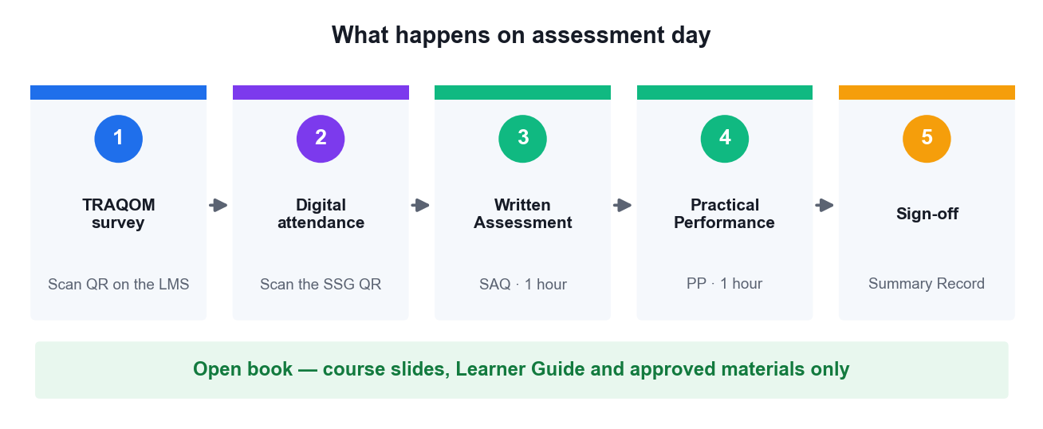
ON ASSESSMENT DAY
Assessment Flow
Complete every step in order — the TRAQOM survey and digital attendance are mandatory for funding.
Securing the Future with Quantum Computing and Cryptography · TGS-2024043419
© 2026 Tertiary Infotech Academy Pte Ltd
12

Slide 14
GETTING STARTED
Why Quantum, Why Now
Securing the Future with Quantum Computing and Cryptography · TGS-2024043419
© 2026 Tertiary Infotech Academy Pte Ltd
13

Slide 15
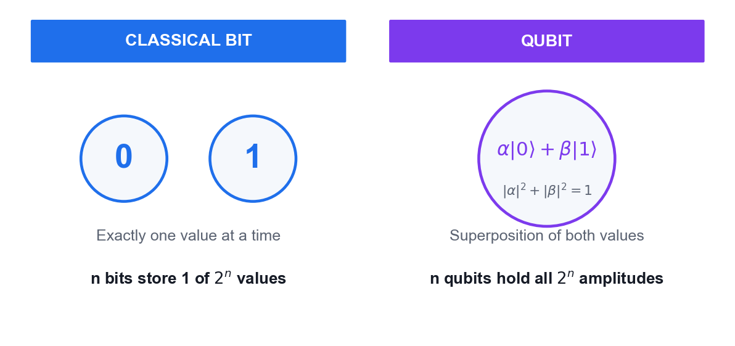
THE CORE IDEA
What Makes a Qubit Different
Classical bit
Holds exactly one value — 0 or 1 — at any instant.
Qubit
Holds a superposition of both, described by two complex amplitudes.
Measurement
Collapses the superposition to a single classical outcome.
The payoff
n qubits carry 2ⁿ amplitudes at once — quantum parallelism.
Securing the Future with Quantum Computing and Cryptography · TGS-2024043419
© 2026 Tertiary Infotech Academy Pte Ltd
14

Slide 16
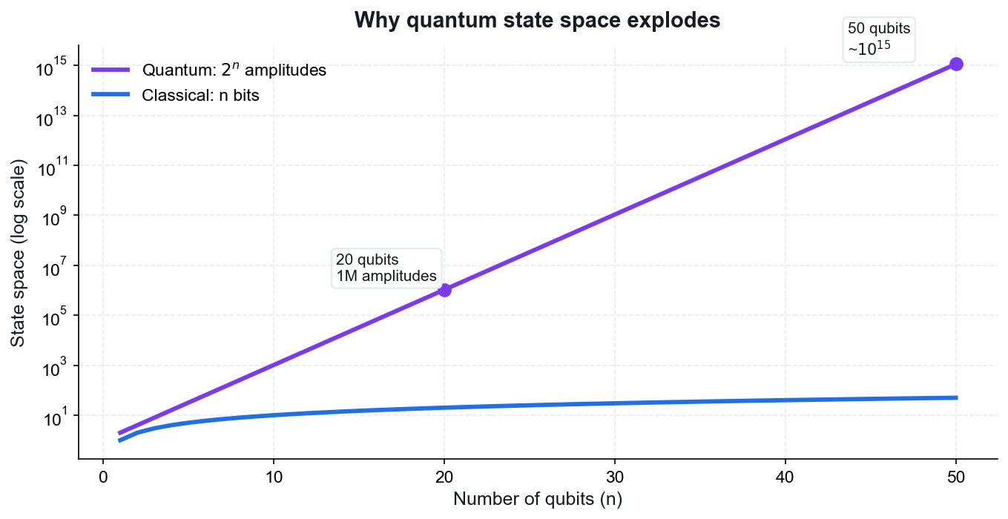
WHY IT MATTERS
The State Space Explosion
50 qubits
~10¹⁵ amplitudes — beyond any classical supercomputer's memory.
300 qubits
More amplitudes than atoms in the observable universe.
But
You only ever read out n classical bits — algorithms must be clever.
So
Interference, not brute force, is what gives quantum its advantage.
Securing the Future with Quantum Computing and Cryptography · TGS-2024043419
© 2026 Tertiary Infotech Academy Pte Ltd
15

Slide 17
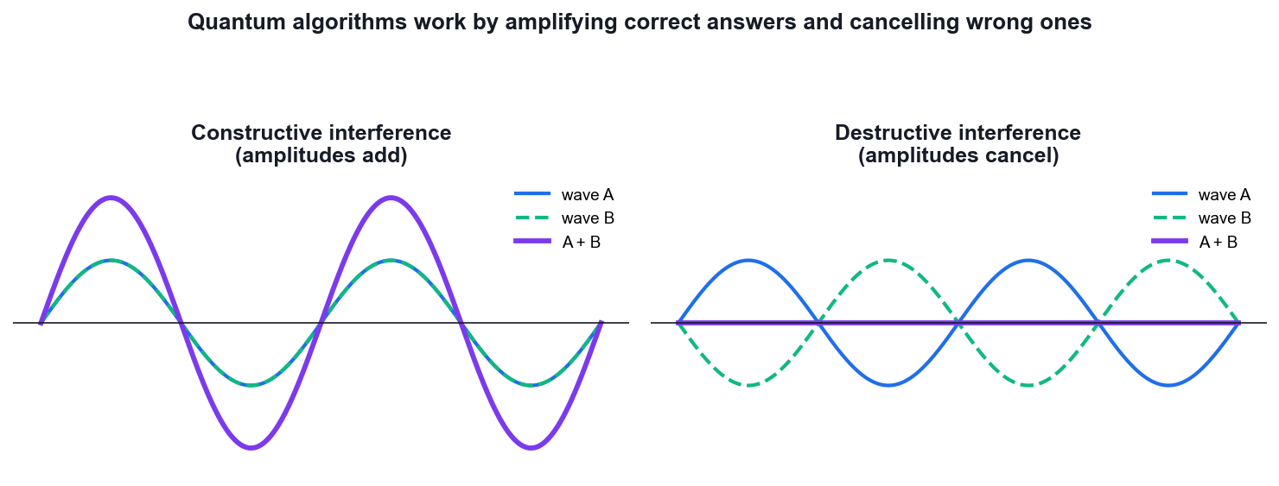
HOW QUANTUM ALGORITHMS WORK
Interference — The Real Engine
Amplitudes can cancel
Unlike probabilities, amplitudes are complex and can be negative.
Wrong answers cancel
A good algorithm arranges destructive interference on wrong paths.
Right answers add
Constructive interference concentrates probability on the answer.
Every algorithm
Deutsch, Grover and Shor are all interference engines.
Securing the Future with Quantum Computing and Cryptography · TGS-2024043419
© 2026 Tertiary Infotech Academy Pte Ltd
16

Slide 18
THE MENTAL MODEL
Superposition supplies the paths. Interference picks the answer.
Every quantum algorithm in this course follows that pattern — prepare a superposition, apply an oracle, then interfere so the correct answer survives.
Securing the Future with Quantum Computing and Cryptography · TGS-2024043419
© 2026 Tertiary Infotech Academy Pte Ltd
17

Slide 19
01
TOPIC 01
Quantum Physics Fundamentals
Postulates of Quantum Mechanics · Mathematics for Quantum Mechanics
Securing the Future with Quantum Computing and Cryptography · TGS-2024043419
© 2026 Tertiary Infotech Academy Pte Ltd
18

Slide 20
MAPS TO LO1
Key Concepts — Quantum Physics Fundamentals
The five postulates
State space, unitary time evolution, observables, the Born rule and wave-function collapse are the axioms every quantum algorithm obeys.
Hilbert space
Quantum states are unit vectors in a complex inner-product space; a single qubit lives in a 2-dimensional Hilbert space.
1
2
Unitary operators
U†U = I preserves the norm — this is why every quantum gate is reversible and probability is conserved.
Hermitian operators
A† = A guarantees real eigenvalues, so Hermitian operators represent physically measurable observables.
3
4
Dirac notation
Bra-ket notation compactly expresses states |ψ⟩, dual vectors ⟨ψ|, inner products ⟨φ|ψ⟩ and outer products |ψ⟩⟨φ|.
Tensor products
The state space of a multi-qubit system is the tensor product of the single-qubit spaces — dimension grows as 2ⁿ.
5
6
Securing the Future with Quantum Computing and Cryptography · TGS-2024043419
© 2026 Tertiary Infotech Academy Pte Ltd
19

Slide 21
THE THREE OBJECTS YOU NEED
The Mathematical Toolkit
State vector
Unitary operator
Hermitian operator
|ψ⟩ = α|0⟩ + β|1⟩
U†U = I
A† = A
A qubit is a unit vector in a 2-dimensional Hilbert space, with |α|² + |β|² = 1.
Every quantum gate is unitary — reversible, and probability-preserving.
Observables are Hermitian, which guarantees real measured eigenvalues.
Securing the Future with Quantum Computing and Cryptography · TGS-2024043419
© 2026 Tertiary Infotech Academy Pte Ltd
20

Slide 22
BRA-KET NOTATION
Dirac Notation at a Glance
Ket / Bra
Inner product
Born rule
|ψ⟩ and ⟨ψ|
⟨φ|ψ⟩
P(x) = |⟨x|ψ⟩|²
A ket is a column vector; a bra is its conjugate transpose (row vector).
A single complex number — the overlap, or probability amplitude, between two states.
The probability of measuring outcome x is the squared magnitude of the amplitude.
Securing the Future with Quantum Computing and Cryptography · TGS-2024043419
© 2026 Tertiary Infotech Academy Pte Ltd
21

Slide 23
THE AXIOMS OF QUANTUM MECHANICS
The Five Postulates
#
Postulate
What it says
1
State space
A system's state is a unit vector in a complex Hilbert space.
2
Time evolution
A closed system evolves by a unitary operator: |ψ'⟩ = U|ψ⟩.
3
Observables
Measurable quantities are Hermitian operators with real eigenvalues.
4
Born rule
The probability of an outcome is the squared amplitude.
5
Collapse
After measurement the state collapses to the measured eigenstate.
Securing the Future with Quantum Computing and Cryptography · TGS-2024043419
© 2026 Tertiary Infotech Academy Pte Ltd
22

Slide 24
WHAT YOU'LL DO
Hands-On Activities — Quantum Physics Fundamentals
Activity 1
—
—
• Linear Algebra for Quantum Mechanics in Python
• —
• —
Securing the Future with Quantum Computing and Cryptography · TGS-2024043419
© 2026 Tertiary Infotech Academy Pte Ltd
23

Slide 25
TOPIC 01 · HANDS-ON ACTIVITY
ACTIVITY 1
Linear Algebra for Quantum Mechanics in Python
Work with the mathematical objects every quantum algorithm is built from: state vectors, inner and outer products, unitary and Hermitian operators, eigenvalues and tensor products — all in NumPy.
MAPS TO LO1 — Design mathematical models required for quantum computing applications
YOU'LL PRODUCE
A Python notebook that verifies unitarity and Hermiticity, computes eigenvalues/eigenvectors, and builds two-qubit states with the tensor product.
Tools: Python 3.13, NumPy, Google Colab / VS Code
Full step-by-step guide: Learner Guide — Activity 1: Linear Algebra for Quantum Mechanics in Python
Securing the Future with Quantum Computing and Cryptography · TGS-2024043419
© 2026 Tertiary Infotech Academy Pte Ltd
24

Slide 26
ACTIVITY 1 · VERIFY & DEBRIEF
Linear Algebra for Quantum Mechanics in Python
TEST IT — HOW YOU KNOW IT WORKED
H-dagger H equals the identity, X and Z return real eigenvalues +1 and -1, the Born-rule probability of measuring 0 in |+> is 0.5, and the tensor product produces a 4-component two-qubit state.
DISCUSS WITH YOUR TRAINER
What did the result show?
Why does it work?
Where would you use it?
Restate the outcome in your own words.
Name the quantum principle the activity relies on.
Give one realistic application in your own field.
Securing the Future with Quantum Computing and Cryptography · TGS-2024043419
© 2026 Tertiary Infotech Academy Pte Ltd
25

Slide 27
TOPIC RECAP
Recap — Quantum Physics Fundamentals
• The five postulates
• Hilbert space
• Unitary operators
• Hermitian operators
• Dirac notation
• Tensor products
Securing the Future with Quantum Computing and Cryptography · TGS-2024043419
© 2026 Tertiary Infotech Academy Pte Ltd
26

Slide 28
02
TOPIC 02
Introduction to Quantum Computing Systems
Overview of quantum computers · Commercial systems · Superposition and Entanglement
Securing the Future with Quantum Computing and Cryptography · TGS-2024043419
© 2026 Tertiary Infotech Academy Pte Ltd
27

Slide 29
MAPS TO LO2, LO4
Key Concepts — Introduction to Quantum Computing Systems
Qubit vs classical bit
A bit is 0 or 1; a qubit is α|0⟩ + β|1⟩ with |α|² + |β|² = 1, allowing superposition of both values.
Bloch sphere
Every pure single-qubit state maps to a point on the unit sphere — the standard geometric picture of qubit state and rotation.
1
2
Physical qubits
Superconducting (Josephson junction), trapped-ion and topological qubits trade off speed, coherence time and connectivity.
Commercial platforms
IBM Quantum, Google, IonQ, Rigetti and D-Wave offer cloud access to real quantum processors today.
3
4
Superposition
A quantum register of n qubits holds a superposition of all 2ⁿ basis states simultaneously — the source of quantum parallelism.
Entanglement
Entangled states cannot be written as a product of single-qubit states; measuring one qubit instantly correlates with the other.
5
6
Securing the Future with Quantum Computing and Cryptography · TGS-2024043419
© 2026 Tertiary Infotech Academy Pte Ltd
28

Slide 30
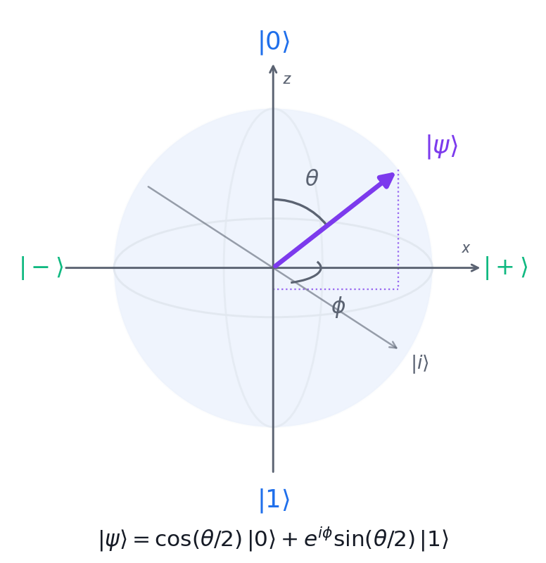
GEOMETRY OF A SINGLE QUBIT
Visualising a Qubit — The Bloch Sphere
North / south poles
|0⟩ and |1⟩ — the classical computational basis states.
The equator
Equal superpositions such as |+⟩ and |−⟩ — maximally uncertain in Z.
θ sets probability
cos²(θ/2) is the chance of measuring 0.
φ sets phase
Invisible to a Z measurement, but it drives interference.
Securing the Future with Quantum Computing and Cryptography · TGS-2024043419
© 2026 Tertiary Infotech Academy Pte Ltd
29

Slide 31
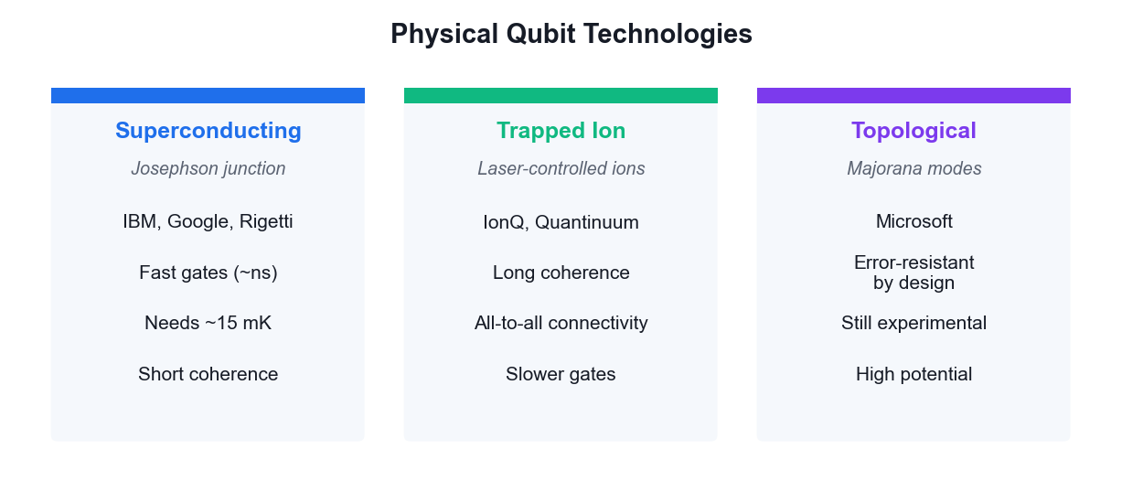
HOW QUBITS ARE ACTUALLY BUILT
Physical Qubit Technologies
No technology has won yet — each trades gate speed against coherence time and connectivity.
Securing the Future with Quantum Computing and Cryptography · TGS-2024043419
© 2026 Tertiary Infotech Academy Pte Ltd
30

Slide 32
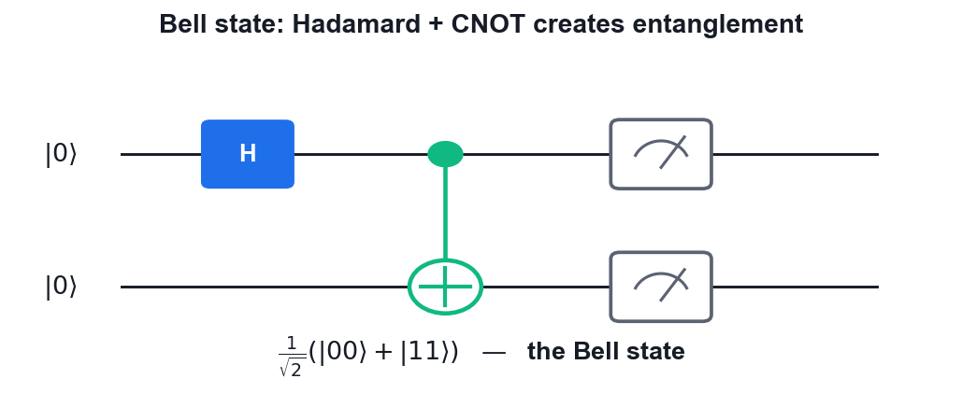
THE MOST IMPORTANT TWO-QUBIT STATE
Entanglement — The Bell State
Two gates
A Hadamard followed by a CNOT is all it takes.
Perfect correlation
Measure 0 on one qubit and the other is certainly 0.
Not separable
The state cannot be written as a product of two single-qubit states.
The resource
Teleportation, superdense coding and QKD all consume entanglement.
Securing the Future with Quantum Computing and Cryptography · TGS-2024043419
© 2026 Tertiary Infotech Academy Pte Ltd
31

Slide 33
WHAT YOU'LL DO
Hands-On Activities — Introduction to Quantum Computing Systems
Activity 2
Activity 3
—
• Visualising a Qubit on the Bloch Sphere
• Superposition and Entanglement on IBM Quantum
• —
Securing the Future with Quantum Computing and Cryptography · TGS-2024043419
© 2026 Tertiary Infotech Academy Pte Ltd
32

Slide 34
TOPIC 02 · HANDS-ON ACTIVITY
ACTIVITY 2
Visualising a Qubit on the Bloch Sphere
Build single-qubit states in Qiskit and plot them on the Bloch sphere, so you can see how gates rotate a qubit and what superposition and phase actually look like geometrically.
MAPS TO LO2 — Decide on appropriate physical methodologies specific to quantum computing problems
YOU'LL PRODUCE
A set of Bloch-sphere plots showing |0>, |1>, |+>, |-> and an arbitrary Ry-rotated state.
Tools: Qiskit 2.x, matplotlib, Google Colab
Full step-by-step guide: Learner Guide — Activity 2: Visualising a Qubit on the Bloch Sphere
Securing the Future with Quantum Computing and Cryptography · TGS-2024043419
© 2026 Tertiary Infotech Academy Pte Ltd
33

Slide 35
ACTIVITY 2 · VERIFY & DEBRIEF
Visualising a Qubit on the Bloch Sphere
TEST IT — HOW YOU KNOW IT WORKED
|0> sits at the north pole, X moves it to the south pole, H places it on the equator at +x, and the S gate rotates it around the equator while leaving the Z-basis probabilities at 50/50.
DISCUSS WITH YOUR TRAINER
What did the result show?
Why does it work?
Where would you use it?
Restate the outcome in your own words.
Name the quantum principle the activity relies on.
Give one realistic application in your own field.
Securing the Future with Quantum Computing and Cryptography · TGS-2024043419
© 2026 Tertiary Infotech Academy Pte Ltd
34

Slide 36
TOPIC 02 · HANDS-ON ACTIVITY
ACTIVITY 3
Superposition and Entanglement on IBM Quantum
Create your IBM Quantum account, build a superposition circuit and a two-qubit Bell state, and run them on a real quantum processor to see genuine quantum randomness and correlation in the results.
MAPS TO LO2, LO4 — Evaluate quantum computing applicability in the business context
YOU'LL PRODUCE
A Bell state circuit executed on real IBM Quantum hardware, with a measured histogram showing the |00> and |11> correlation.
Tools: IBM Quantum Platform, Qiskit Runtime, Python 3.13
Full step-by-step guide: Learner Guide — Activity 3: Superposition and Entanglement on IBM Quantum
Securing the Future with Quantum Computing and Cryptography · TGS-2024043419
© 2026 Tertiary Infotech Academy Pte Ltd
35

Slide 37
ACTIVITY 3 · VERIFY & DEBRIEF
Superposition and Entanglement on IBM Quantum
TEST IT — HOW YOU KNOW IT WORKED
The superposition circuit gives roughly 50% |0> and 50% |1>; the Bell circuit gives roughly 50% |00> and 50% |11> with only a small percentage of |01> and |10> counts caused by hardware noise.
DISCUSS WITH YOUR TRAINER
What did the result show?
Why does it work?
Where would you use it?
Restate the outcome in your own words.
Name the quantum principle the activity relies on.
Give one realistic application in your own field.
Securing the Future with Quantum Computing and Cryptography · TGS-2024043419
© 2026 Tertiary Infotech Academy Pte Ltd
36

Slide 38
TOPIC RECAP
Recap — Introduction to Quantum Computing Systems
• Qubit vs classical bit
• Bloch sphere
• Physical qubits
• Commercial platforms
• Superposition
• Entanglement
Securing the Future with Quantum Computing and Cryptography · TGS-2024043419
© 2026 Tertiary Infotech Academy Pte Ltd
37

Slide 39
03
TOPIC 03
Quantum Gates and Circuits
Single Qubit Gates · Multi Qubit Gates · Bell and GHZ States · Phase Kickback
Securing the Future with Quantum Computing and Cryptography · TGS-2024043419
© 2026 Tertiary Infotech Academy Pte Ltd
38

Slide 40
MAPS TO LO3, LO5
Key Concepts — Quantum Gates and Circuits
Pauli gates
X (bit flip), Y and Z (phase flip) are self-inverse, Hermitian and unitary — the building blocks of single-qubit logic.
Hadamard gate
H maps |0⟩ → |+⟩ and |1⟩ → |−⟩, creating the equal superposition that starts nearly every quantum algorithm.
1
2
Rotation and phase gates
Rx, Ry, Rz rotate the Bloch vector; S and T are special cases of the phase gate P(θ).
Multi-qubit gates
CNOT, CZ, controlled-phase, SWAP and Toffoli (CCNOT) create the entanglement that makes quantum computing powerful.
3
4
Bell and GHZ states
H followed by CNOT produces a maximally entangled Bell pair; extending to n qubits gives the GHZ state.
Phase kickback
A controlled operation on an eigenstate transfers the eigenvalue phase back to the control qubit — the engine of Deutsch, BV and QPE.
5
6
Securing the Future with Quantum Computing and Cryptography · TGS-2024043419
© 2026 Tertiary Infotech Academy Pte Ltd
39

Slide 41
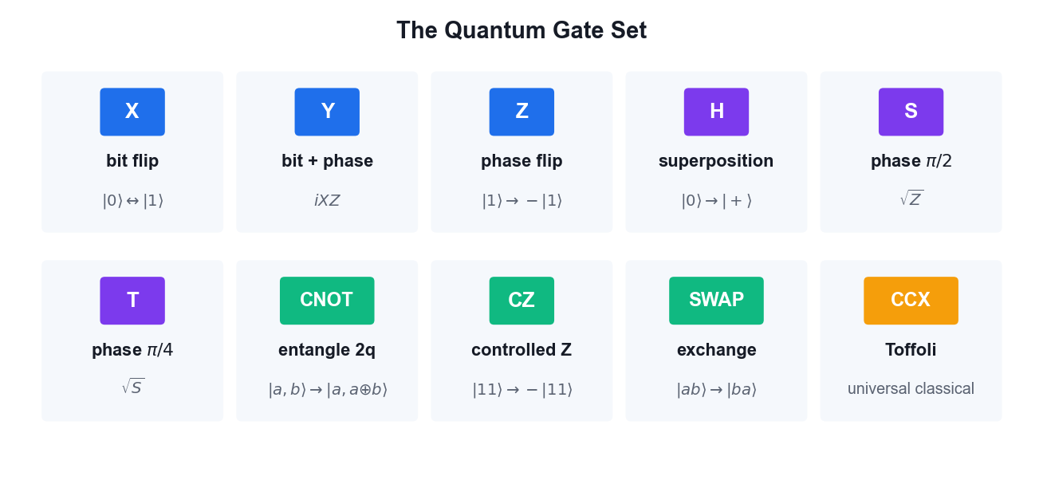
YOUR GATE VOCABULARY
The Quantum Gate Set
Single-qubit gates rotate the Bloch vector; two-qubit gates create the entanglement that makes quantum computing powerful.
Securing the Future with Quantum Computing and Cryptography · TGS-2024043419
© 2026 Tertiary Infotech Academy Pte Ltd
40

Slide 42
GATE REFERENCE
Single vs Multi-Qubit Gates
Gate
Qubits
Effect
Used for
X / Y / Z
1
Rotate π about an axis
Bit flip, phase flip
H
1
Basis change
Create superposition
S / T
1
Phase π/2 and π/4
Fine phase control
Rx / Ry / Rz
1
Arbitrary rotation
Variational ansätze
CNOT
2
Flip target if control is 1
Entanglement, oracles
CZ / CP
2
Conditional phase
QFT, phase kickback
SWAP
2
Exchange two qubits
Routing on hardware
Toffoli
3
Flip if both controls are 1
Reversible classical logic
Securing the Future with Quantum Computing and Cryptography · TGS-2024043419
© 2026 Tertiary Infotech Academy Pte Ltd
41

Slide 43
THE KEY MECHANISM
Phase kickback is the trick behind almost every algorithm.
Apply a controlled-U to an eigenstate of U and the eigenvalue phase appears on the CONTROL qubit — that is how Deutsch, Bernstein-Vazirani, phase estimation and Shor all extract their answers.
Securing the Future with Quantum Computing and Cryptography · TGS-2024043419
© 2026 Tertiary Infotech Academy Pte Ltd
42

Slide 44
WHAT YOU'LL DO
Hands-On Activities — Quantum Gates and Circuits
Activity 4
Activity 5
—
• Building Circuits in IBM Quantum Composer
• Quantum Gates and Bell/GHZ States with PennyLane
• —
Securing the Future with Quantum Computing and Cryptography · TGS-2024043419
© 2026 Tertiary Infotech Academy Pte Ltd
43

Slide 45
TOPIC 03 · HANDS-ON ACTIVITY
ACTIVITY 4
Building Circuits in IBM Quantum Composer
Use the drag-and-drop IBM Quantum Composer to build single- and multi-qubit circuits, watch the state vector and probability panels update live, and export the circuit as OpenQASM.
MAPS TO LO5 — Spearhead the application of quantum gates to quantum computing domains
YOU'LL PRODUCE
A set of Composer circuits (X, H, CNOT, Bell state) with their statevector output, exported as OpenQASM 3 code.
Tools: IBM Quantum Composer, OpenQASM 3
Full step-by-step guide: Learner Guide — Activity 4: Building Circuits in IBM Quantum Composer
Securing the Future with Quantum Computing and Cryptography · TGS-2024043419
© 2026 Tertiary Infotech Academy Pte Ltd
44

Slide 46
ACTIVITY 4 · VERIFY & DEBRIEF
Building Circuits in IBM Quantum Composer
TEST IT — HOW YOU KNOW IT WORKED
The Composer probability panel shows a 50/50 split between |00> and |11> for the Bell circuit, and the exported OpenQASM contains an h instruction followed by a cx instruction.
DISCUSS WITH YOUR TRAINER
What did the result show?
Why does it work?
Where would you use it?
Restate the outcome in your own words.
Name the quantum principle the activity relies on.
Give one realistic application in your own field.
Securing the Future with Quantum Computing and Cryptography · TGS-2024043419
© 2026 Tertiary Infotech Academy Pte Ltd
45

Slide 47
TOPIC 03 · HANDS-ON ACTIVITY
ACTIVITY 5
Quantum Gates and Bell/GHZ States with PennyLane
Use PennyLane's quantum-function and QNode model to apply the full single- and multi-qubit gate set, then construct Bell and GHZ entangled states and verify their measurement correlations.
MAPS TO LO3, LO5 — Direct two-level quantum models and apply quantum gates
YOU'LL PRODUCE
A PennyLane script that draws each circuit, returns the state vector, and confirms the Bell and GHZ correlations.
Tools: PennyLane, Python 3.13, matplotlib
Full step-by-step guide: Learner Guide — Activity 5: Quantum Gates and Bell/GHZ States with PennyLane
Securing the Future with Quantum Computing and Cryptography · TGS-2024043419
© 2026 Tertiary Infotech Academy Pte Ltd
46

Slide 48
ACTIVITY 5 · VERIFY & DEBRIEF
Quantum Gates and Bell/GHZ States with PennyLane
TEST IT — HOW YOU KNOW IT WORKED
The Bell state returns amplitudes of about 0.707 on |00> and |11> and zero elsewhere; the GHZ state returns amplitudes only on |000> and |111>; the phase-kickback circuit shows the eigenvalue phase transferred to the control qubit.
DISCUSS WITH YOUR TRAINER
What did the result show?
Why does it work?
Where would you use it?
Restate the outcome in your own words.
Name the quantum principle the activity relies on.
Give one realistic application in your own field.
Securing the Future with Quantum Computing and Cryptography · TGS-2024043419
© 2026 Tertiary Infotech Academy Pte Ltd
47

Slide 49
TOPIC RECAP
Recap — Quantum Gates and Circuits
• Pauli gates
• Hadamard gate
• Rotation and phase gates
• Multi-qubit gates
• Bell and GHZ states
• Phase kickback
Securing the Future with Quantum Computing and Cryptography · TGS-2024043419
© 2026 Tertiary Infotech Academy Pte Ltd
48

Slide 50
04
TOPIC 04
Quantum Protocols
No-Cloning Theorem · Teleportation · Superdense Coding · BB84 QKD · CHSH Game
Securing the Future with Quantum Computing and Cryptography · TGS-2024043419
© 2026 Tertiary Infotech Academy Pte Ltd
49

Slide 51
MAPS TO LO3, LO7
Key Concepts — Quantum Protocols
No-cloning theorem
No unitary can copy an arbitrary unknown quantum state — proved by linearity, and the foundation of quantum key security.
Quantum teleportation
Transfers an unknown qubit state using one shared Bell pair plus two classical bits — no faster-than-light signalling.
1
2
Superdense coding
The dual of teleportation: send two classical bits by transmitting a single qubit of a pre-shared entangled pair.
BB84 QKD
Alice and Bob build a shared secret key using random bases; eavesdropping disturbs the states and raises the error rate.
3
4
Eavesdropping detection
An intercept-resend attack introduces roughly a 25% error rate in the sifted key, revealing Eve's presence.
CHSH game
A quantum strategy using entanglement wins ~85% of the time versus the classical maximum of 75%, disproving local hidden variables.
5
6
Securing the Future with Quantum Computing and Cryptography · TGS-2024043419
© 2026 Tertiary Infotech Academy Pte Ltd
50

Slide 52
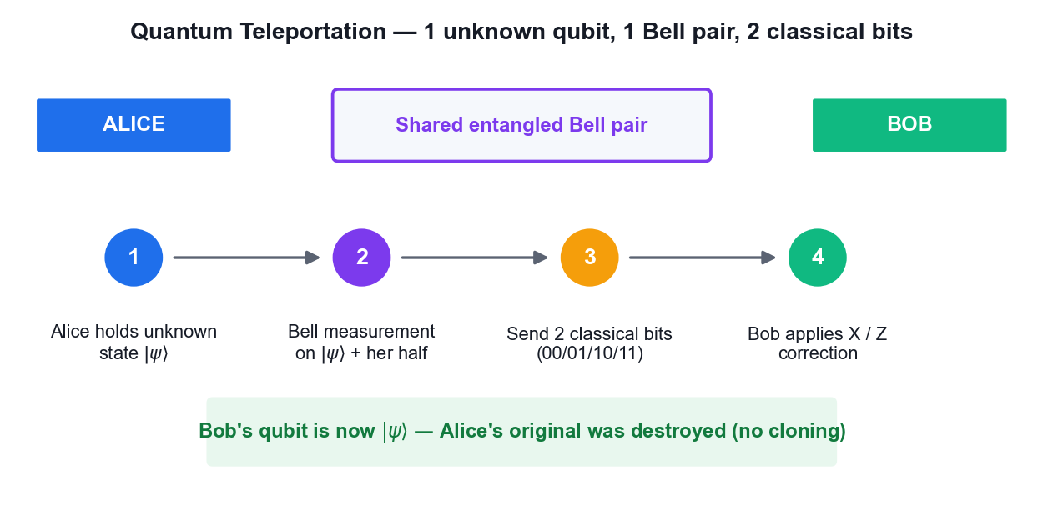
MOVING A STATE WITHOUT MOVING A PARTICLE
Quantum Teleportation
Two classical bits must still travel — so teleportation never beats the speed of light.
Securing the Future with Quantum Computing and Cryptography · TGS-2024043419
© 2026 Tertiary Infotech Academy Pte Ltd
51

Slide 53
TWO SIDES OF ONE COIN
Teleportation vs Superdense Coding
Qubit → classical channel
Classical → qubit channel
• Quantum Teleportation
– Sends: 1 unknown QUBIT state
– Costs: 1 Bell pair + 2 classical bits
– Original is destroyed (no cloning)
– Use: moving quantum data
• Superdense Coding
– Sends: 2 CLASSICAL bits
– Costs: 1 Bell pair + 1 transmitted qubit
– Encode with I, X, Z or ZX
– Use: doubling channel capacity
Securing the Future with Quantum Computing and Cryptography · TGS-2024043419
© 2026 Tertiary Infotech Academy Pte Ltd
52

Slide 54
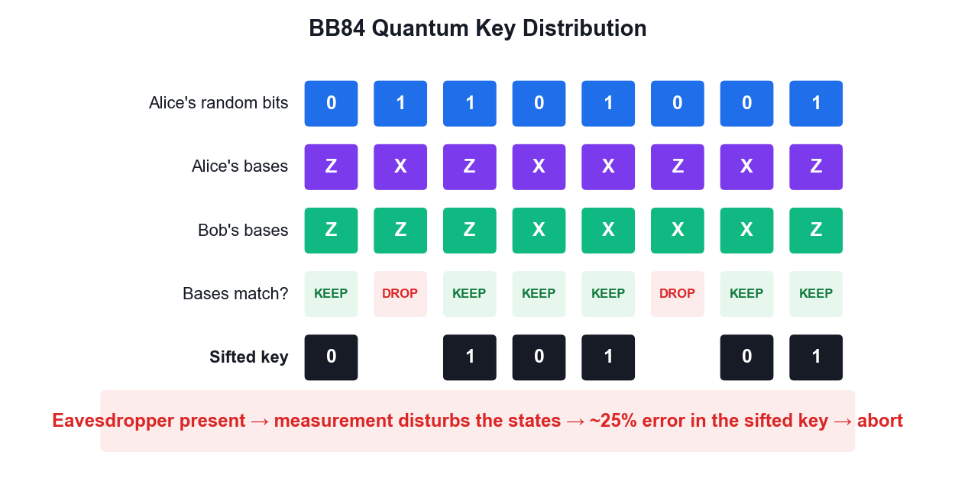
SECURITY FROM PHYSICS, NOT MATHS
BB84 Quantum Key Distribution
Security rests on the no-cloning theorem — an eavesdropper cannot copy the qubits without disturbing them.
Securing the Future with Quantum Computing and Cryptography · TGS-2024043419
© 2026 Tertiary Infotech Academy Pte Ltd
53

Slide 55
WHAT YOU'LL DO
Hands-On Activities — Quantum Protocols
Activity 6
Activity 7
Activity 8
• Quantum Teleportation
• Superdense Coding Protocol
• BB84 Quantum Key Distribution with Eavesdropping Detection
Securing the Future with Quantum Computing and Cryptography · TGS-2024043419
© 2026 Tertiary Infotech Academy Pte Ltd
54

Slide 56
TOPIC 04 · HANDS-ON ACTIVITY
ACTIVITY 6
Quantum Teleportation
Implement the three-qubit teleportation protocol: entangle a shared pair, perform a Bell measurement on the unknown state, and apply the conditional corrections that recreate the original state on Bob's qubit.
MAPS TO LO3, LO7 — Synthesize quantum methodologies to address complex problems
YOU'LL PRODUCE
A teleportation circuit run on IBM Quantum hardware that reconstructs an arbitrary input state at the receiving qubit.
Tools: Qiskit 2.x, IBM Quantum Runtime, OpenQASM
Full step-by-step guide: Learner Guide — Activity 6: Quantum Teleportation
Securing the Future with Quantum Computing and Cryptography · TGS-2024043419
© 2026 Tertiary Infotech Academy Pte Ltd
55

Slide 57
ACTIVITY 6 · VERIFY & DEBRIEF
Quantum Teleportation
TEST IT — HOW YOU KNOW IT WORKED
The measurement statistics on Bob's qubit q2 match the amplitudes of the state originally prepared on q0, within hardware noise, and the original state no longer exists on q0.
DISCUSS WITH YOUR TRAINER
What did the result show?
Why does it work?
Where would you use it?
Restate the outcome in your own words.
Name the quantum principle the activity relies on.
Give one realistic application in your own field.
Securing the Future with Quantum Computing and Cryptography · TGS-2024043419
© 2026 Tertiary Infotech Academy Pte Ltd
56

Slide 58
TOPIC 04 · HANDS-ON ACTIVITY
ACTIVITY 7
Superdense Coding Protocol
Implement the dual of teleportation: transmit two classical bits by sending only a single qubit of a pre-shared entangled pair, encoding the message with the I, X, Z and XZ operations.
MAPS TO LO3, LO7 — Direct two-level quantum models for quantum computing
YOU'LL PRODUCE
A superdense coding circuit that correctly transmits all four two-bit messages 00, 01, 10 and 11.
Tools: Qiskit 2.x, IBM Quantum Runtime
Full step-by-step guide: Learner Guide — Activity 7: Superdense Coding Protocol
Securing the Future with Quantum Computing and Cryptography · TGS-2024043419
© 2026 Tertiary Infotech Academy Pte Ltd
57

Slide 59
ACTIVITY 7 · VERIFY & DEBRIEF
Superdense Coding Protocol
TEST IT — HOW YOU KNOW IT WORKED
Each of the four encodings decodes to its intended message — identity gives 00, X gives 01, Z gives 10 and ZX gives 11 — demonstrating two classical bits carried by one transmitted qubit.
DISCUSS WITH YOUR TRAINER
What did the result show?
Why does it work?
Where would you use it?
Restate the outcome in your own words.
Name the quantum principle the activity relies on.
Give one realistic application in your own field.
Securing the Future with Quantum Computing and Cryptography · TGS-2024043419
© 2026 Tertiary Infotech Academy Pte Ltd
58

Slide 60
TOPIC 04 · HANDS-ON ACTIVITY
ACTIVITY 8
BB84 Quantum Key Distribution with Eavesdropping Detection
Run the BB84 protocol end to end: random bit and basis selection, quantum transmission, basis sifting and key extraction — then repeat it with an eavesdropper present and measure the error rate that exposes the attack.
MAPS TO LO7 — Synthesize quantum methodologies to address complex problems
YOU'LL PRODUCE
A working BB84 implementation producing a shared secret key, plus a comparison run showing the ~25% error rate introduced by an intercept-resend eavesdropper.
Tools: Qiskit 2.x, IBM Quantum Runtime, Python
Full step-by-step guide: Learner Guide — Activity 8: BB84 Quantum Key Distribution with Eavesdropping Detection
Securing the Future with Quantum Computing and Cryptography · TGS-2024043419
© 2026 Tertiary Infotech Academy Pte Ltd
59

Slide 61
ACTIVITY 8 · VERIFY & DEBRIEF
BB84 Quantum Key Distribution with Eavesdropping Detection
TEST IT — HOW YOU KNOW IT WORKED
Without an eavesdropper the sifted key error rate is near zero (bounded only by hardware noise); with the intercept-resend eavesdropper the error rate rises to roughly 25%, which is the signal to abort and discard the key.
DISCUSS WITH YOUR TRAINER
What did the result show?
Why does it work?
Where would you use it?
Restate the outcome in your own words.
Name the quantum principle the activity relies on.
Give one realistic application in your own field.
Securing the Future with Quantum Computing and Cryptography · TGS-2024043419
© 2026 Tertiary Infotech Academy Pte Ltd
60

Slide 62
TOPIC RECAP
Recap — Quantum Protocols
• No-cloning theorem
• Quantum teleportation
• Superdense coding
• BB84 QKD
• Eavesdropping detection
• CHSH game
Securing the Future with Quantum Computing and Cryptography · TGS-2024043419
© 2026 Tertiary Infotech Academy Pte Ltd
61

Slide 63
05
TOPIC 05
Quantum Algorithms
Deutsch · Deutsch-Jozsa · Bernstein-Vazirani · Grover · Quantum Fourier Transform
Securing the Future with Quantum Computing and Cryptography · TGS-2024043419
© 2026 Tertiary Infotech Academy Pte Ltd
62

Slide 64
MAPS TO LO6, LO7
Key Concepts — Quantum Algorithms
The query (oracle) model
Algorithms are compared by how many times they query a black-box function — the standard measure of quantum advantage.
Deutsch algorithm
Decides whether f:{0,1}→{0,1} is constant or balanced with ONE query; classically two are required.
1
2
Deutsch-Jozsa
Extends the idea to n bits — one query versus 2ⁿ⁻¹+1 classical queries in the worst case: exponential separation.
Bernstein-Vazirani
Recovers an n-bit hidden string s from f(x) = s·x (mod 2) in a single query instead of n.
3
4
Grover search
Amplitude amplification finds a marked item in an unstructured database in O(√N) instead of O(N) — a quadratic speedup.
Quantum Fourier Transform
The quantum analogue of the DFT runs in O(n²) gates and underpins phase estimation and Shor's algorithm.
5
6
Securing the Future with Quantum Computing and Cryptography · TGS-2024043419
© 2026 Tertiary Infotech Academy Pte Ltd
63

Slide 65
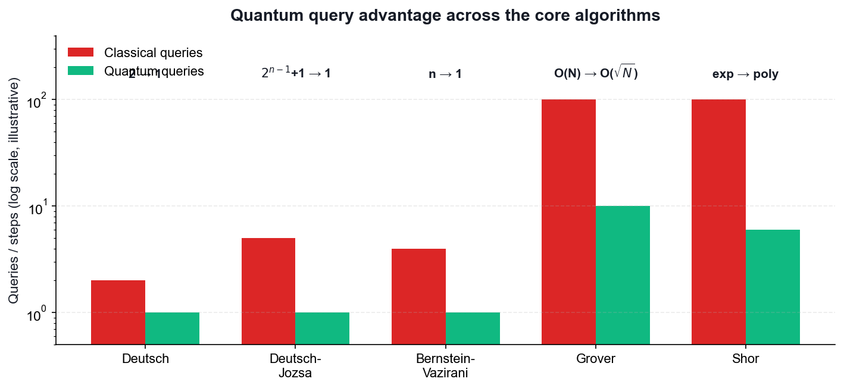
WHY THESE ALGORITHMS MATTER
Quantum Query Advantage
Query counts are illustrative — the point is the SCALING, not the absolute numbers.
Securing the Future with Quantum Computing and Cryptography · TGS-2024043419
© 2026 Tertiary Infotech Academy Pte Ltd
64

Slide 66
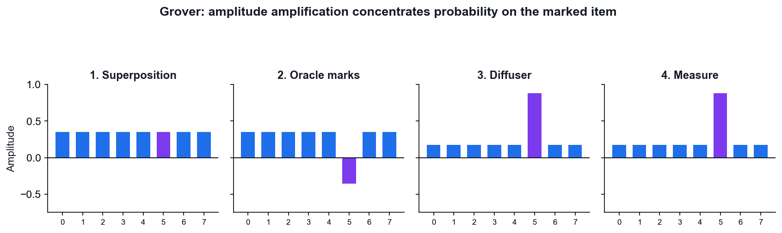
HOW GROVER ACTUALLY WORKS
Grover — Amplitude Amplification
Start
All N states share an equal amplitude of 1/√N.
Oracle
Flips the SIGN of the marked state — invisible to measurement so far.
Diffuser
Reflects every amplitude about the mean, growing the marked one.
Repeat
About (π/4)√N times — then measure.
Securing the Future with Quantum Computing and Cryptography · TGS-2024043419
© 2026 Tertiary Infotech Academy Pte Ltd
65

Slide 67
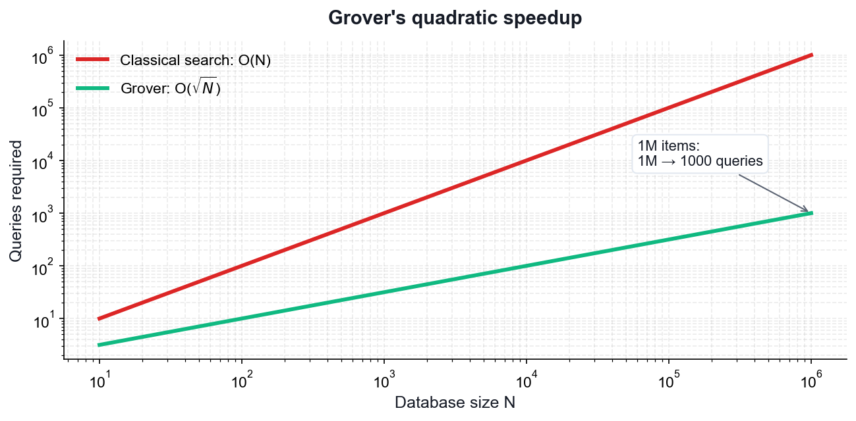
THE SCALING
Grover's Quadratic Speedup
Classical
Checking an unstructured list takes O(N) queries.
Grover
Finds the marked item in O(√N) queries.
1M items
1,000,000 checks become roughly 1,000.
Not exponential
A real speedup, but far smaller than Shor's.
Securing the Future with Quantum Computing and Cryptography · TGS-2024043419
© 2026 Tertiary Infotech Academy Pte Ltd
66

Slide 68
WHAT YOU'LL DO
Hands-On Activities — Quantum Algorithms
Activities 9–10
Activities 11–12
—
• Deutsch and Deutsch-Jozsa Algorithms
• Bernstein-Vazirani Algorithm
• Grover's Search Algorithm
• Quantum Fourier Transform
• —
Securing the Future with Quantum Computing and Cryptography · TGS-2024043419
© 2026 Tertiary Infotech Academy Pte Ltd
67

Slide 69
TOPIC 05 · HANDS-ON ACTIVITY
ACTIVITY 9
Deutsch and Deutsch-Jozsa Algorithms
Implement the first algorithms to show a provable quantum advantage: decide whether a black-box function is constant or balanced with a single query, then generalise from one input bit to n.
MAPS TO LO6 — Establish guidelines for selecting quantum computing algorithms
YOU'LL PRODUCE
Deutsch and Deutsch-Jozsa circuits with all four oracle types, run on IBM Quantum hardware, correctly classifying each function in one query.
Tools: Qiskit 2.x, IBM Quantum Runtime, OpenQASM
Full step-by-step guide: Learner Guide — Activity 9: Deutsch and Deutsch-Jozsa Algorithms
Securing the Future with Quantum Computing and Cryptography · TGS-2024043419
© 2026 Tertiary Infotech Academy Pte Ltd
68

Slide 70
ACTIVITY 9 · VERIFY & DEBRIEF
Deutsch and Deutsch-Jozsa Algorithms
TEST IT — HOW YOU KNOW IT WORKED
The Deutsch circuit measures 0 for both constant oracles and 1 for both balanced oracles; Deutsch-Jozsa returns the all-zeros string for a constant function and a non-zero string for a balanced function — each using exactly one oracle query.
DISCUSS WITH YOUR TRAINER
What did the result show?
Why does it work?
Where would you use it?
Restate the outcome in your own words.
Name the quantum principle the activity relies on.
Give one realistic application in your own field.
Securing the Future with Quantum Computing and Cryptography · TGS-2024043419
© 2026 Tertiary Infotech Academy Pte Ltd
69

Slide 71
TOPIC 05 · HANDS-ON ACTIVITY
ACTIVITY 10
Bernstein-Vazirani Algorithm
Recover an n-bit hidden string in a single oracle query. Classically you would need n queries — one per bit — making this a clean demonstration of linear-to-constant query speedup.
MAPS TO LO6 — Establish guidelines for selecting quantum computing algorithms
YOU'LL PRODUCE
A Bernstein-Vazirani circuit that recovers a chosen hidden string such as 1011 in one query on real hardware.
Tools: Qiskit 2.x, IBM Quantum Runtime
Full step-by-step guide: Learner Guide — Activity 10: Bernstein-Vazirani Algorithm
Securing the Future with Quantum Computing and Cryptography · TGS-2024043419
© 2026 Tertiary Infotech Academy Pte Ltd
70

Slide 72
ACTIVITY 10 · VERIFY & DEBRIEF
Bernstein-Vazirani Algorithm
TEST IT — HOW YOU KNOW IT WORKED
The most frequent measured bit string equals the hidden string s that was encoded in the oracle, recovered with a single oracle query regardless of the length of s.
DISCUSS WITH YOUR TRAINER
What did the result show?
Why does it work?
Where would you use it?
Restate the outcome in your own words.
Name the quantum principle the activity relies on.
Give one realistic application in your own field.
Securing the Future with Quantum Computing and Cryptography · TGS-2024043419
© 2026 Tertiary Infotech Academy Pte Ltd
71

Slide 73
TOPIC 05 · HANDS-ON ACTIVITY
ACTIVITY 11
Grover's Search Algorithm
Implement amplitude amplification to find a marked item in an unstructured search space, using the phase oracle and the diffuser, and see the quadratic O(sqrt(N)) speedup for 2-qubit and 3-qubit searches.
MAPS TO LO6, LO7 — Select algorithms and synthesize quantum methodologies
YOU'LL PRODUCE
Grover circuits for 2 and 3 qubits that amplify the marked state to a high measurement probability on real hardware.
Tools: Qiskit 2.x, IBM Quantum Runtime, OpenQASM
Full step-by-step guide: Learner Guide — Activity 11: Grover's Search Algorithm
Securing the Future with Quantum Computing and Cryptography · TGS-2024043419
© 2026 Tertiary Infotech Academy Pte Ltd
72

Slide 74
ACTIVITY 11 · VERIFY & DEBRIEF
Grover's Search Algorithm
TEST IT — HOW YOU KNOW IT WORKED
For 2 qubits the marked state is measured with near-certainty after one Grover iteration; for 3 qubits it dominates the histogram after two iterations; applying too many iterations visibly reduces the success probability.
DISCUSS WITH YOUR TRAINER
What did the result show?
Why does it work?
Where would you use it?
Restate the outcome in your own words.
Name the quantum principle the activity relies on.
Give one realistic application in your own field.
Securing the Future with Quantum Computing and Cryptography · TGS-2024043419
© 2026 Tertiary Infotech Academy Pte Ltd
73

Slide 75
TOPIC 05 · HANDS-ON ACTIVITY
ACTIVITY 12
Quantum Fourier Transform
Build the QFT circuit from Hadamard and controlled-phase gates, verify it against the classical DFT, and understand why it is the engine behind phase estimation and Shor's algorithm.
MAPS TO LO6, LO7 — Establish guidelines for selecting quantum computing algorithms
YOU'LL PRODUCE
QFT circuits for 3, 4 and 5 qubits, validated against a classical DFT reference and run on IBM Quantum hardware.
Tools: Qiskit 2.x, NumPy, IBM Quantum Runtime, OpenQASM
Full step-by-step guide: Learner Guide — Activity 12: Quantum Fourier Transform
Securing the Future with Quantum Computing and Cryptography · TGS-2024043419
© 2026 Tertiary Infotech Academy Pte Ltd
74

Slide 76
ACTIVITY 12 · VERIFY & DEBRIEF
Quantum Fourier Transform
TEST IT — HOW YOU KNOW IT WORKED
Your hand-built QFT circuit produces the same state vector as Qiskit's built-in QFT and matches a normalised classical FFT of the same input, using on the order of n^2 gates.
DISCUSS WITH YOUR TRAINER
What did the result show?
Why does it work?
Where would you use it?
Restate the outcome in your own words.
Name the quantum principle the activity relies on.
Give one realistic application in your own field.
Securing the Future with Quantum Computing and Cryptography · TGS-2024043419
© 2026 Tertiary Infotech Academy Pte Ltd
75

Slide 77
TOPIC RECAP
Recap — Quantum Algorithms
• The query (oracle) model
• Deutsch algorithm
• Deutsch-Jozsa
• Bernstein-Vazirani
• Grover search
• Quantum Fourier Transform
Securing the Future with Quantum Computing and Cryptography · TGS-2024043419
© 2026 Tertiary Infotech Academy Pte Ltd
76

Slide 78
06
TOPIC 06
Quantum Cryptography and Quantum Safety
Classical Cryptography · The Quantum Threat · Shor Algorithm · Post-Quantum Cryptography
Securing the Future with Quantum Computing and Cryptography · TGS-2024043419
© 2026 Tertiary Infotech Academy Pte Ltd
77

Slide 79
MAPS TO LO4, LO7
Key Concepts — Quantum Cryptography and Quantum Safety
Goals of cryptography
Confidentiality, integrity, authentication and non-repudiation are the four properties every scheme must address.
Classical schemes
Symmetric (AES), asymmetric (RSA, ECC) and hash functions (SHA-256) rest on problems that are hard for classical computers.
1
2
The quantum threat
Shor's algorithm breaks RSA and ECC in polynomial time; Grover halves the effective key length of symmetric ciphers.
Shor's algorithm
Reduces factoring to period-finding, then uses the QFT to extract the period — turning a hard problem into an easy one.
3
4
Harvest now, decrypt later
Adversaries can record encrypted traffic today and decrypt it once a cryptographically relevant quantum computer exists.
Post-quantum cryptography
NIST has standardised ML-KEM (Kyber), ML-DSA (Dilithium), SLH-DSA (SPHINCS+) and HQC as quantum-resistant replacements.
5
6
Securing the Future with Quantum Computing and Cryptography · TGS-2024043419
© 2026 Tertiary Infotech Academy Pte Ltd
78

Slide 80
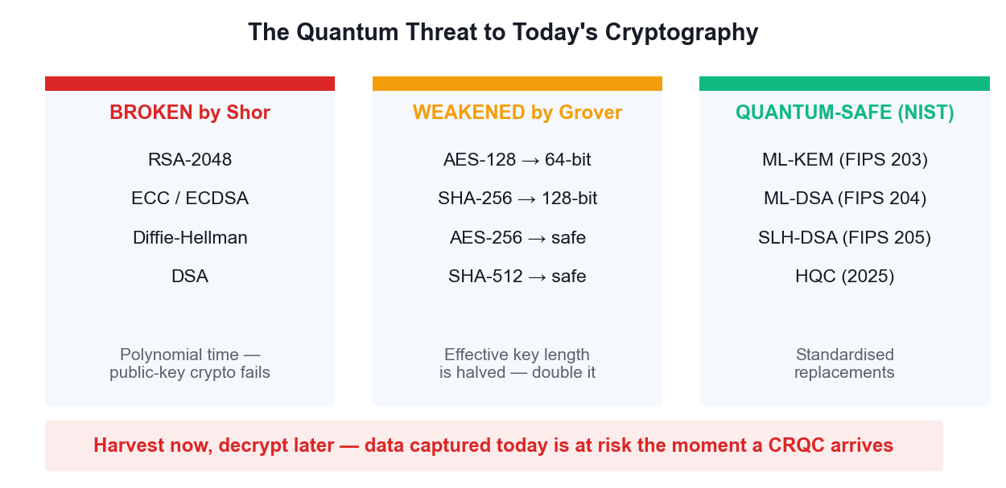
WHAT BREAKS AND WHAT SURVIVES
The Quantum Threat to Cryptography
Symmetric crypto survives by doubling key length; public-key crypto must be replaced outright.
Securing the Future with Quantum Computing and Cryptography · TGS-2024043419
© 2026 Tertiary Infotech Academy Pte Ltd
79

Slide 81
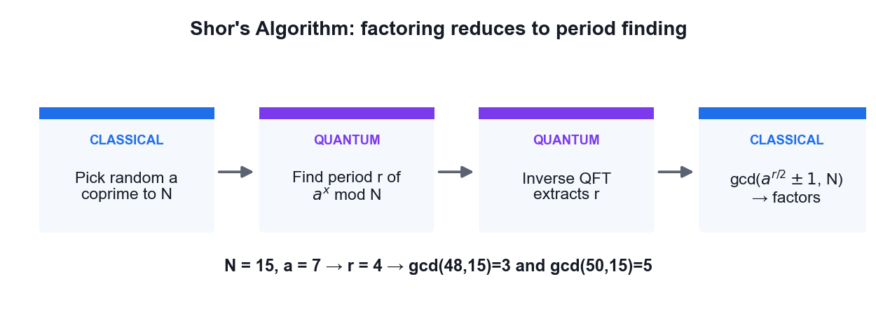
FACTORING VIA PERIOD FINDING
Shor's Algorithm
Only the period-finding step is quantum — the rest is classical number theory.
Securing the Future with Quantum Computing and Cryptography · TGS-2024043419
© 2026 Tertiary Infotech Academy Pte Ltd
80

Slide 82
THE FOUR GOALS: CONFIDENTIALITY · INTEGRITY · AUTHENTICATION · NON-REPUDIATION
Classical Cryptography — What You Must Know
Type
Example
Key
Broken by
Symmetric
AES-256
One shared secret key
Grover (halves strength)
Asymmetric
RSA-2048, ECC
Public + private key pair
Shor (fully broken)
Hash
SHA-256
No key
Grover (halves strength)
PQC KEM
ML-KEM (Kyber)
Lattice-based
Not known to be broken
PQC signature
ML-DSA, SLH-DSA
Lattice / hash-based
Not known to be broken
Securing the Future with Quantum Computing and Cryptography · TGS-2024043419
© 2026 Tertiary Infotech Academy Pte Ltd
81

Slide 83
WHY MIGRATE BEFORE THE THREAT ARRIVES
Harvest now, decrypt later.
An adversary can record your encrypted traffic today and decrypt it the day a cryptographically relevant quantum computer exists. Any secret that must stay confidential for a decade is already at risk.
Securing the Future with Quantum Computing and Cryptography · TGS-2024043419
© 2026 Tertiary Infotech Academy Pte Ltd
82

Slide 84
WHAT YOU'LL DO
Hands-On Activities — Quantum Cryptography and Quantum Safety
Activity 13
Activity 14
—
• Shor's Algorithm and the Quantum Threat to RSA
• Post-Quantum Cryptography Migration Assessment
• —
Securing the Future with Quantum Computing and Cryptography · TGS-2024043419
© 2026 Tertiary Infotech Academy Pte Ltd
83

Slide 85
TOPIC 06 · HANDS-ON ACTIVITY
ACTIVITY 13
Shor's Algorithm and the Quantum Threat to RSA
See how factoring reduces to period finding, run the quantum period-finding circuit that sits at the heart of Shor's algorithm, and recover the factors of N = 15 from the measured period.
MAPS TO LO7 — Synthesize quantum methodologies to address complex problems
YOU'LL PRODUCE
A period-finding circuit whose measured output yields the period r, from which the factors of N = 15 are classically recovered.
Tools: Qiskit 2.x, IBM Quantum Runtime, Python, OpenQASM
Full step-by-step guide: Learner Guide — Activity 13: Shor's Algorithm and the Quantum Threat to RSA
Securing the Future with Quantum Computing and Cryptography · TGS-2024043419
© 2026 Tertiary Infotech Academy Pte Ltd
84

Slide 86
ACTIVITY 13 · VERIFY & DEBRIEF
Shor's Algorithm and the Quantum Threat to RSA
TEST IT — HOW YOU KNOW IT WORKED
The measured phase yields period r = 4 for a = 7 and N = 15, and the classical post-processing step recovers the correct factors 3 and 5.
DISCUSS WITH YOUR TRAINER
What did the result show?
Why does it work?
Where would you use it?
Restate the outcome in your own words.
Name the quantum principle the activity relies on.
Give one realistic application in your own field.
Securing the Future with Quantum Computing and Cryptography · TGS-2024043419
© 2026 Tertiary Infotech Academy Pte Ltd
85

Slide 87
TOPIC 06 · HANDS-ON ACTIVITY
ACTIVITY 14
Post-Quantum Cryptography Migration Assessment
Assess which cryptography in a realistic system is broken by a quantum computer, map each algorithm to its NIST post-quantum replacement, and produce a prioritised migration plan against the harvest-now-decrypt-later risk.
MAPS TO LO4, LO7 — Evaluate quantum applicability in the business context
YOU'LL PRODUCE
A completed cryptographic inventory and a prioritised PQC migration plan for a sample organisation.
Tools: NIST FIPS 203/204/205, OpenSSL, Python
Full step-by-step guide: Learner Guide — Activity 14: Post-Quantum Cryptography Migration Assessment
Securing the Future with Quantum Computing and Cryptography · TGS-2024043419
© 2026 Tertiary Infotech Academy Pte Ltd
86

Slide 88
ACTIVITY 14 · VERIFY & DEBRIEF
Post-Quantum Cryptography Migration Assessment
TEST IT — HOW YOU KNOW IT WORKED
Your inventory correctly separates Shor-broken asymmetric algorithms from Grover-weakened symmetric ones, maps each to the correct NIST FIPS standard, and ranks migration priority by how long the data must remain confidential.
DISCUSS WITH YOUR TRAINER
What did the result show?
Why does it work?
Where would you use it?
Restate the outcome in your own words.
Name the quantum principle the activity relies on.
Give one realistic application in your own field.
Securing the Future with Quantum Computing and Cryptography · TGS-2024043419
© 2026 Tertiary Infotech Academy Pte Ltd
87

Slide 89
TOPIC RECAP
Recap — Quantum Cryptography and Quantum Safety
• Goals of cryptography
• Classical schemes
• The quantum threat
• Shor's algorithm
• Harvest now, decrypt later
• Post-quantum cryptography
Securing the Future with Quantum Computing and Cryptography · TGS-2024043419
© 2026 Tertiary Infotech Academy Pte Ltd
88

Slide 90
07
TOPIC 07
Quantum Computing Applications and Use Cases
Finance · Healthcare · Science
Securing the Future with Quantum Computing and Cryptography · TGS-2024043419
© 2026 Tertiary Infotech Academy Pte Ltd
89

Slide 91
MAPS TO LO4
Key Concepts — Quantum Computing Applications and Use Cases
Finance
Portfolio optimisation, derivative pricing via amplitude estimation, credit risk and fraud detection are the leading finance use cases.
Healthcare and life sciences
Molecular simulation with VQE, protein folding and accelerated drug discovery target problems classical HPC cannot reach.
1
2
Science and materials
Simulating catalysts, superconductors, nitrogen fixation and battery chemistry is quantum computing's most natural application.
Optimisation and logistics
QAOA addresses routing, scheduling and Max-Cut style combinatorial problems across supply chains and energy grids.
3
4
Quantum machine learning
Quantum kernels and variational classifiers explore feature spaces that are expensive to compute classically.
Assessing business value
Evaluate a use case on problem structure, data size, required qubit count and whether a classical method already suffices.
5
6
Securing the Future with Quantum Computing and Cryptography · TGS-2024043419
© 2026 Tertiary Infotech Academy Pte Ltd
90

Slide 92
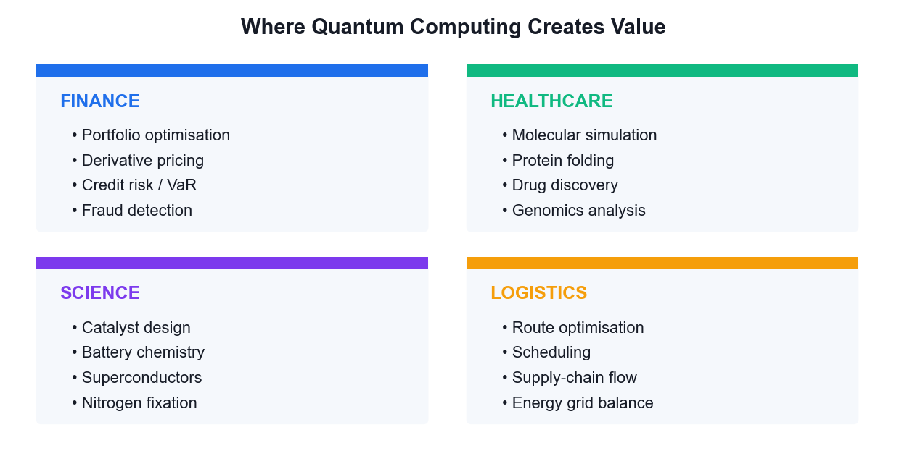
USE CASES BY SECTOR
Where Quantum Creates Value
The best candidates are problems with quantum structure — chemistry and optimisation — not big-data problems.
Securing the Future with Quantum Computing and Cryptography · TGS-2024043419
© 2026 Tertiary Infotech Academy Pte Ltd
91

Slide 93
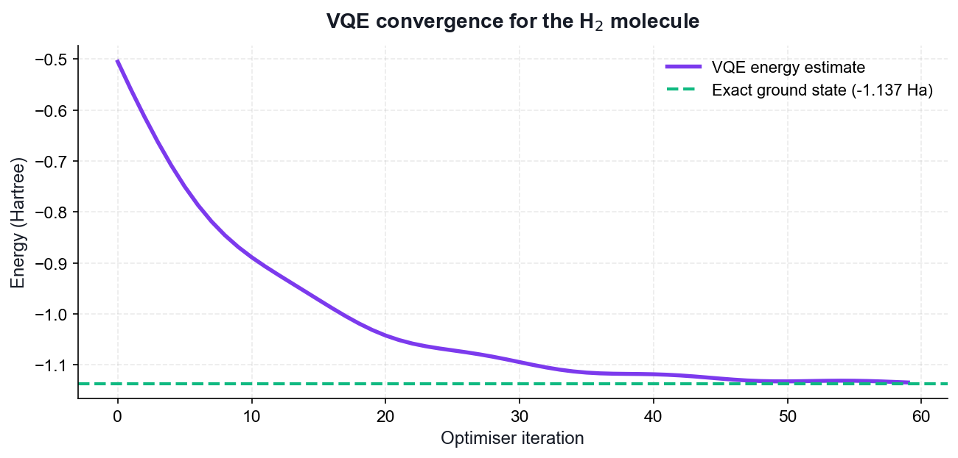
THE FLAGSHIP NEAR-TERM APPLICATION
VQE — Simulating Molecules
Hybrid loop
A quantum circuit prepares the trial state; a classical optimiser tunes it.
Noise tolerant
Shallow circuits make VQE practical on today's NISQ hardware.
The target
Ground-state energy — the quantity that drives chemistry.
The prize
Catalysts, batteries and drug candidates simulated exactly.
Securing the Future with Quantum Computing and Cryptography · TGS-2024043419
© 2026 Tertiary Infotech Academy Pte Ltd
92

Slide 94
A PRACTICAL CHECKLIST FOR LO4
Assessing a Quantum Use Case
Does the problem have quantum structure?
Chemistry and optimisation map naturally; generic data processing does not.
How big is the data?
Loading large classical datasets into a quantum computer is itself a bottleneck.
1
2
What qubit count is needed?
Estimate logical qubits, then multiply for error-correction overhead.
Is there a good classical method?
If a classical heuristic already solves it well, quantum adds nothing.
3
4
What is the time horizon?
NISQ demos today; fault-tolerant advantage is a 2030s proposition.
What is the cost of waiting?
For cryptography the answer is high — migrate now.
5
6
Securing the Future with Quantum Computing and Cryptography · TGS-2024043419
© 2026 Tertiary Infotech Academy Pte Ltd
93

Slide 95
WHAT YOU'LL DO
Hands-On Activities — Quantum Computing Applications and Use Cases
Activity 15
Activity 16
—
• Molecular Simulation with VQE (Healthcare & Science)
• Portfolio Optimisation with QAOA (Finance)
• —
Securing the Future with Quantum Computing and Cryptography · TGS-2024043419
© 2026 Tertiary Infotech Academy Pte Ltd
94

Slide 96
TOPIC 07 · HANDS-ON ACTIVITY
ACTIVITY 15
Molecular Simulation with VQE (Healthcare & Science)
Run the Variational Quantum Eigensolver to compute the ground-state energy of the hydrogen molecule — the flagship near-term use case for drug discovery, catalysis and materials science.
MAPS TO LO4, LO7 — Evaluate quantum computing applicability in the business context
YOU'LL PRODUCE
A VQE run that converges to the H2 ground-state energy, with an energy-versus-iteration convergence plot.
Tools: Qiskit 2.x, SciPy optimiser, matplotlib, IBM Quantum
Full step-by-step guide: Learner Guide — Activity 15: Molecular Simulation with VQE (Healthcare & Science)
Securing the Future with Quantum Computing and Cryptography · TGS-2024043419
© 2026 Tertiary Infotech Academy Pte Ltd
95

Slide 97
ACTIVITY 15 · VERIFY & DEBRIEF
Molecular Simulation with VQE (Healthcare & Science)
TEST IT — HOW YOU KNOW IT WORKED
The VQE optimisation converges to an energy close to the exact H2 ground-state value of about -1.137 Hartree, and the convergence plot shows the energy decreasing monotonically toward that limit.
DISCUSS WITH YOUR TRAINER
What did the result show?
Why does it work?
Where would you use it?
Restate the outcome in your own words.
Name the quantum principle the activity relies on.
Give one realistic application in your own field.
Securing the Future with Quantum Computing and Cryptography · TGS-2024043419
© 2026 Tertiary Infotech Academy Pte Ltd
96

Slide 98
TOPIC 07 · HANDS-ON ACTIVITY
ACTIVITY 16
Portfolio Optimisation with QAOA (Finance)
Apply the Quantum Approximate Optimization Algorithm to a Max-Cut style combinatorial problem, the same structure that underlies portfolio selection, routing and scheduling in financial services.
MAPS TO LO4, LO6 — Evaluate applicability and select appropriate algorithms
YOU'LL PRODUCE
A QAOA run that finds the optimal cut on a small graph, with the solution quality compared against brute force.
Tools: Qiskit 2.x, NetworkX, SciPy, matplotlib
Full step-by-step guide: Learner Guide — Activity 16: Portfolio Optimisation with QAOA (Finance)
Securing the Future with Quantum Computing and Cryptography · TGS-2024043419
© 2026 Tertiary Infotech Academy Pte Ltd
97

Slide 99
ACTIVITY 16 · VERIFY & DEBRIEF
Portfolio Optimisation with QAOA (Finance)
TEST IT — HOW YOU KNOW IT WORKED
The most frequently sampled bit string from the optimised QAOA circuit corresponds to the true maximum cut found by brute force, and the approximation ratio improves as the number of layers p increases.
DISCUSS WITH YOUR TRAINER
What did the result show?
Why does it work?
Where would you use it?
Restate the outcome in your own words.
Name the quantum principle the activity relies on.
Give one realistic application in your own field.
Securing the Future with Quantum Computing and Cryptography · TGS-2024043419
© 2026 Tertiary Infotech Academy Pte Ltd
98

Slide 100
TOPIC RECAP
Recap — Quantum Computing Applications and Use Cases
• Finance
• Healthcare and life sciences
• Science and materials
• Optimisation and logistics
• Quantum machine learning
• Assessing business value
Securing the Future with Quantum Computing and Cryptography · TGS-2024043419
© 2026 Tertiary Infotech Academy Pte Ltd
99

Slide 101
08
TOPIC 08
Quantum Error Correction
Bit and Phase Flip Errors · QEC Algorithms · Fault Tolerance · The Future
Securing the Future with Quantum Computing and Cryptography · TGS-2024043419
© 2026 Tertiary Infotech Academy Pte Ltd
100

Slide 102
MAPS TO LO7
Key Concepts — Quantum Error Correction
Why QEC is needed
Qubits decohere and gates are imperfect; without correction, errors accumulate long before a useful algorithm completes.
Quantum-specific challenges
No-cloning forbids simple copying, errors are continuous rather than discrete, and measurement destroys the state.
1
2
Syndrome measurement
Ancilla qubits are measured to reveal WHICH error occurred without ever measuring — and collapsing — the logical state.
Bit-flip and phase-flip codes
Three-qubit repetition codes correct X errors; conjugating with Hadamards turns phase flips into bit flips.
3
4
Shor, Steane and surface codes
Shor's 9-qubit code corrects arbitrary single-qubit errors; Steane uses 7; surface codes are today's leading practical approach.
Fault tolerance
Below the error threshold, concatenating codes suppresses errors faster than they accumulate — the path to useful quantum computers.
5
6
Securing the Future with Quantum Computing and Cryptography · TGS-2024043419
© 2026 Tertiary Infotech Academy Pte Ltd
101

Slide 103
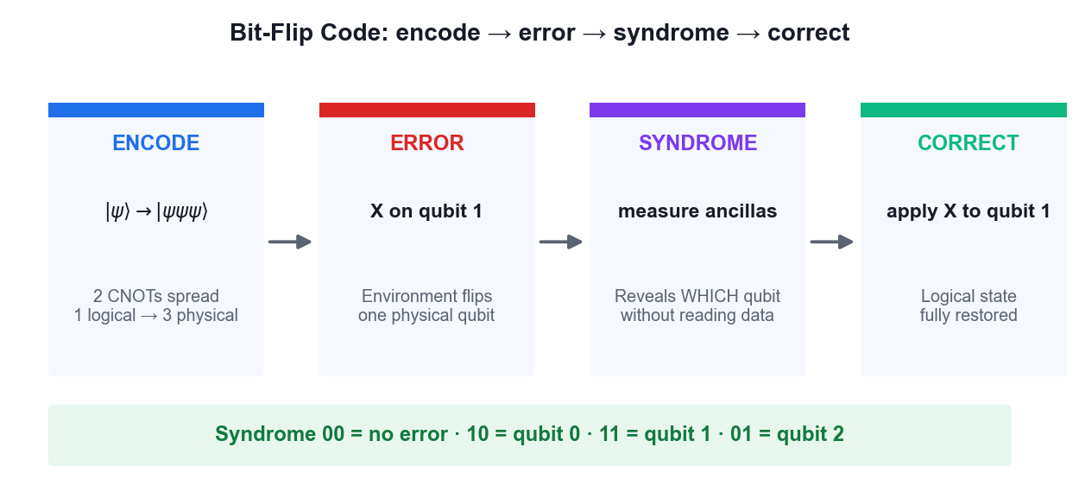
ENCODE · ERROR · SYNDROME · CORRECT
Bit-Flip Code — The QEC Cycle
The syndrome reveals WHICH qubit flipped without ever measuring — and destroying — the logical state.
Securing the Future with Quantum Computing and Cryptography · TGS-2024043419
© 2026 Tertiary Infotech Academy Pte Ltd
102

Slide 104
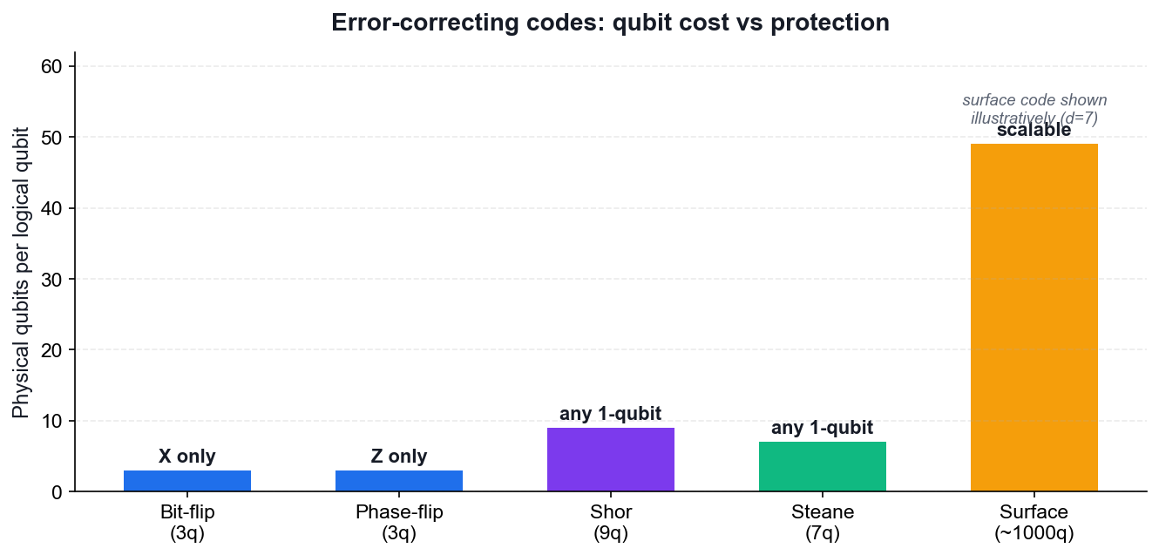
QUBIT COST VS PROTECTION
Error-Correcting Codes Compared
3-qubit codes
Correct either bit flips or phase flips, but not both.
Shor 9-qubit
The first code to correct an arbitrary single-qubit error.
Steane 7-qubit
A CSS code achieving the same protection more efficiently.
Surface codes
2D nearest-neighbour layout — today's leading practical approach.
Securing the Future with Quantum Computing and Cryptography · TGS-2024043419
© 2026 Tertiary Infotech Academy Pte Ltd
103

Slide 105
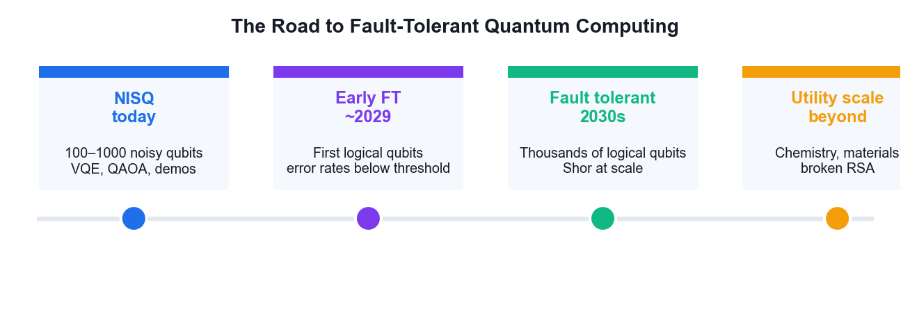
WHERE THE INDUSTRY IS HEADED
The Road to Fault Tolerance
Below the error threshold, adding more physical qubits suppresses errors faster than they accumulate.
Securing the Future with Quantum Computing and Cryptography · TGS-2024043419
© 2026 Tertiary Infotech Academy Pte Ltd
104

Slide 106
WHAT YOU'LL DO
Hands-On Activities — Quantum Error Correction
Activity 17
Activity 18
—
• Bit-Flip and Phase-Flip Error Correction Codes
• Shor 9-Qubit and Steane 7-Qubit Codes
• —
Securing the Future with Quantum Computing and Cryptography · TGS-2024043419
© 2026 Tertiary Infotech Academy Pte Ltd
105

Slide 107
TOPIC 08 · HANDS-ON ACTIVITY
ACTIVITY 17
Bit-Flip and Phase-Flip Error Correction Codes
Build the three-qubit repetition codes that detect and correct X and Z errors: encode a logical qubit, inject an error, measure the syndrome without collapsing the state, and apply the correction.
MAPS TO LO7 — Synthesize quantum methodologies to address complex problems
YOU'LL PRODUCE
Working bit-flip and phase-flip code circuits that correctly identify and repair an injected single-qubit error.
Tools: Qiskit 2.x, IBM Quantum Runtime, OpenQASM
Full step-by-step guide: Learner Guide — Activity 17: Bit-Flip and Phase-Flip Error Correction Codes
Securing the Future with Quantum Computing and Cryptography · TGS-2024043419
© 2026 Tertiary Infotech Academy Pte Ltd
106

Slide 108
ACTIVITY 17 · VERIFY & DEBRIEF
Bit-Flip and Phase-Flip Error Correction Codes
TEST IT — HOW YOU KNOW IT WORKED
The syndrome measurement correctly identifies which qubit carried the injected error without collapsing the logical state, and applying the indicated correction restores the original logical qubit.
DISCUSS WITH YOUR TRAINER
What did the result show?
Why does it work?
Where would you use it?
Restate the outcome in your own words.
Name the quantum principle the activity relies on.
Give one realistic application in your own field.
Securing the Future with Quantum Computing and Cryptography · TGS-2024043419
© 2026 Tertiary Infotech Academy Pte Ltd
107

Slide 109
TOPIC 08 · HANDS-ON ACTIVITY
ACTIVITY 18
Shor 9-Qubit and Steane 7-Qubit Codes
Step up to codes that correct arbitrary single-qubit errors: Shor's 9-qubit concatenated code and Steane's more efficient 7-qubit CSS code, then compare their qubit overhead and discuss the road to fault tolerance.
MAPS TO LO7 — Synthesize quantum methodologies to address complex problems
YOU'LL PRODUCE
Working Shor 9-qubit and Steane 7-qubit code circuits, with a comparison of qubit cost against protection offered.
Tools: Qiskit 2.x, IBM Quantum Runtime, OpenQASM
Full step-by-step guide: Learner Guide — Activity 18: Shor 9-Qubit and Steane 7-Qubit Codes
Securing the Future with Quantum Computing and Cryptography · TGS-2024043419
© 2026 Tertiary Infotech Academy Pte Ltd
108

Slide 110
ACTIVITY 18 · VERIFY & DEBRIEF
Shor 9-Qubit and Steane 7-Qubit Codes
TEST IT — HOW YOU KNOW IT WORKED
Both the Shor 9-qubit and Steane 7-qubit circuits detect and correct an arbitrary injected single-qubit error (X, Y or Z), and you can state the qubit overhead each code requires.
DISCUSS WITH YOUR TRAINER
What did the result show?
Why does it work?
Where would you use it?
Restate the outcome in your own words.
Name the quantum principle the activity relies on.
Give one realistic application in your own field.
Securing the Future with Quantum Computing and Cryptography · TGS-2024043419
© 2026 Tertiary Infotech Academy Pte Ltd
109

Slide 111
TOPIC RECAP
Recap — Quantum Error Correction
• Why QEC is needed
• Quantum-specific challenges
• Syndrome measurement
• Bit-flip and phase-flip codes
• Shor, Steane and surface codes
• Fault tolerance
Securing the Future with Quantum Computing and Cryptography · TGS-2024043419
© 2026 Tertiary Infotech Academy Pte Ltd
110

Slide 112
WRAP-UP
Course Summary & Next Steps
Securing the Future with Quantum Computing and Cryptography · TGS-2024043419
© 2026 Tertiary Infotech Academy Pte Ltd
111

Slide 113
LEARNING OUTCOMES ACHIEVED
What You Achieved
1
Quantum foundations
Built the state vectors, unitary and Hermitian operators behind every algorithm.
2
Quantum systems
Visualised qubits on the Bloch sphere and ran circuits on real IBM hardware.
3
Gates and circuits
Applied the full gate set and constructed Bell and GHZ entangled states.
4
Quantum protocols
Implemented teleportation, superdense coding and BB84 with eavesdropper detection.
5
Quantum algorithms
Ran Deutsch, Deutsch-Jozsa, Bernstein-Vazirani, Grover and the QFT.
6
Cryptography and safety
Ran Shor's period finding and built a PQC migration plan.
7
Applications
Simulated H₂ with VQE and optimised with QAOA.
8
Error correction
Encoded, diagnosed and corrected errors with the bit-flip, Shor and Steane codes.
Securing the Future with Quantum Computing and Cryptography · TGS-2024043419
© 2026 Tertiary Infotech Academy Pte Ltd
112

Slide 114
NEXT STEPS
Continue Your Quantum Journey
IBM Quantum Learning
Free courses and challenges at learning.quantum.ibm.com.
Qiskit documentation
The reference for every gate, primitive and runtime feature.
1
2
PennyLane demos
Excellent tutorials on variational and quantum-machine-learning methods.
NIST PQC
Track FIPS 203/204/205 adoption and vendor migration guidance.
3
4
Practise the labs
Re-run every activity in this course from a blank notebook.
Stay current
Quantum hardware roadmaps shift yearly — follow the vendor announcements.
5
6
Securing the Future with Quantum Computing and Cryptography · TGS-2024043419
© 2026 Tertiary Infotech Academy Pte Ltd
113

Slide 115
FINAL ASSESSMENT
Assessment
Written Assessment (WA)
Practical Performance (PP)
• Short-Answer Questions (SAQ)
• 1 hour · open book
• Tests underpinning KNOWLEDGE
• Covers all eight topics
• Hands-on quantum tasks
• 1 hour · open book
• Tests PRACTICAL ability
• Built on the class activities
OPEN BOOK — course slides, Learner Guide and approved materials only
Eligibility: minimum 75% attendance + assessed Competent. An appeal process is available.
Securing the Future with Quantum Computing and Cryptography · TGS-2024043419
© 2026 Tertiary Infotech Academy Pte Ltd
114

Slide 116
ON ASSESSMENT DAY
Assessment Flow
Complete every step in order — the TRAQOM survey and digital attendance are mandatory for funding.
Securing the Future with Quantum Computing and Cryptography · TGS-2024043419
© 2026 Tertiary Infotech Academy Pte Ltd
115

Slide 117
TRAQOM · SSG DIGITAL ATTENDANCE
Digital Attendance (Mandatory)
1
2
3
4
▶
▶
▶
Trainer displays the digital attendance QR code from the SSG portal
Scan the QR code with your mobile phone camera
Submit your attendance — AM, PM and Assessment, every day
75% minimum attendance is required for assessment and funding
Securing the Future with Quantum Computing and Cryptography · TGS-2024043419
© 2026 Tertiary Infotech Academy Pte Ltd
116

Slide 118
END OF COURSE
Thank You!
You can now design quantum models, apply quantum gates, select quantum algorithms and plan a post-quantum migration — the skills that secure the future.
Securing the Future with Quantum Computing and Cryptography · TGS-2024043419
© 2026 Tertiary Infotech Academy Pte Ltd
117

